Slide 1
V. CARE
Employee Assistance Program
v3
Your vessel, our responsibility

Slide 2


EAP Orientation
What is the Employee Assistance Program?
Provided through ComPsych
ComPsych provides services to more than 60,000 organizations covering more than 130 million individuals in 190 countries.
ComPsych Corporation is the world’s largest provider of employee assistance programs (EAP).
ComPsych call centers are staffed with mental health, legal, financial and behavior professionals—we work 24 hours day to provide the best service.
Available for all VGroup employees and its absolutely
Free and Confidential
Behavioral health Counseling :
Five (5) face-to-face/telephonic/ Video sessions per issue per year for:
  Work and life relationships
  Stress, anxiety and depression
  Loneliness
  Home sickness
  Grief and loss
  Substance abuse
  Raising children
  Caring for elderly parents
  Caring from Distance

Slide 3
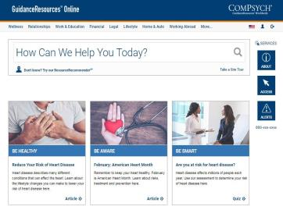

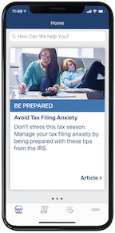


How to Access the EAP
EAP Orientation
ONLINE:
Visit GuidanceResources website:
  www.guidanceresources.com
  Mobile app: GuidanceNow
  Web ID: VGroup
PHONE:
The EAP is available to you 24 hours a day, 7 days a week for services in English and in country native languages

Slide 4
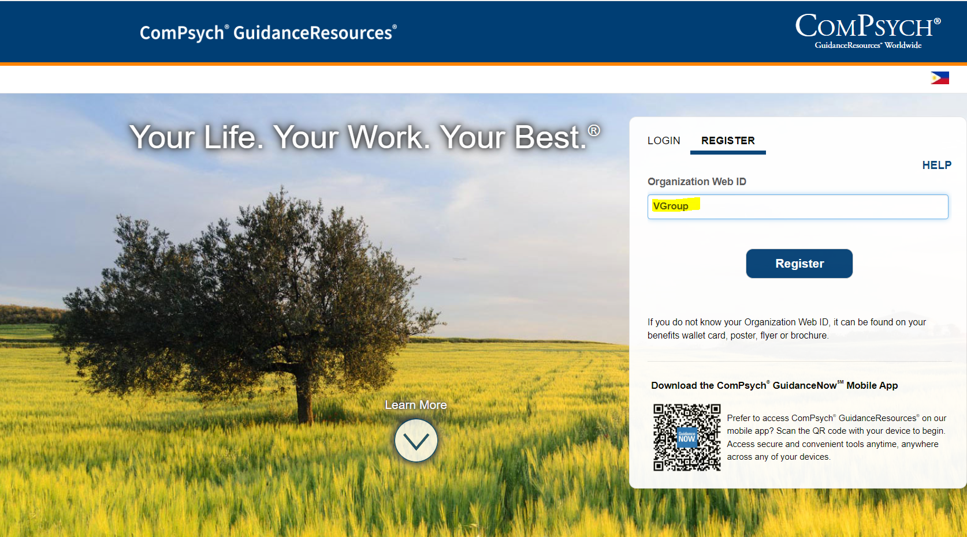
EAP Orientation
How to Register on the Website

Slide 5

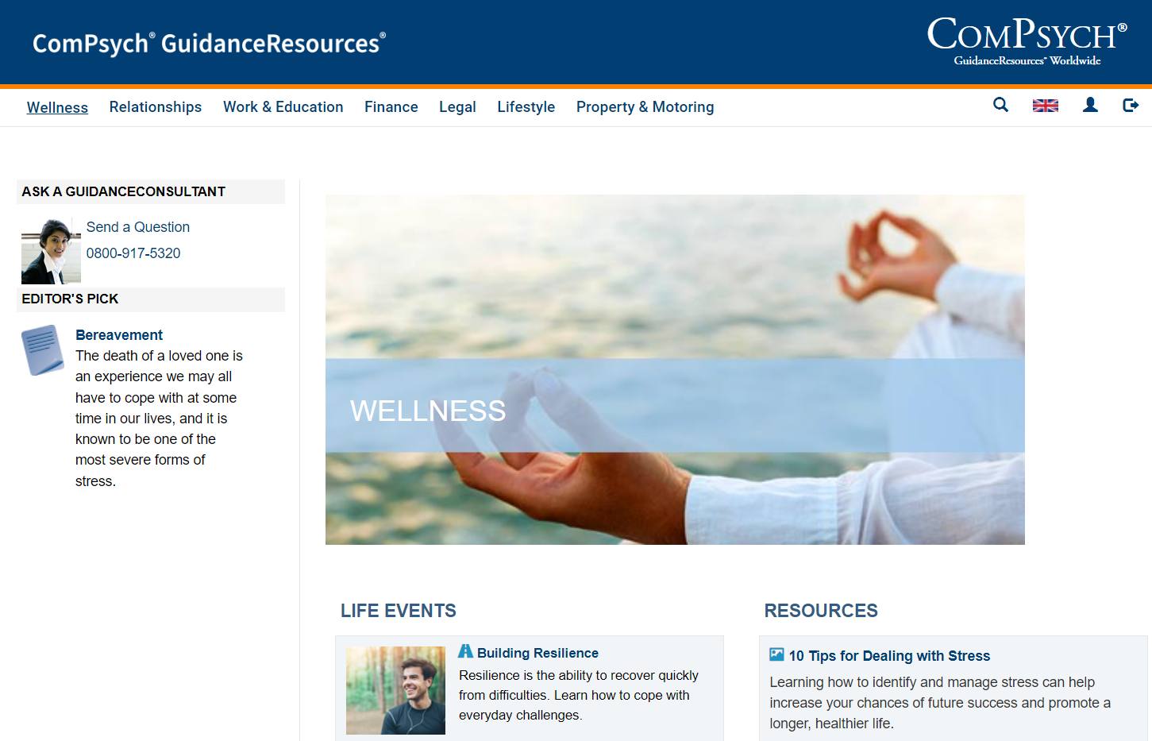

EAP Orientation
Access a Wealth of Varied Resources

Slide 6
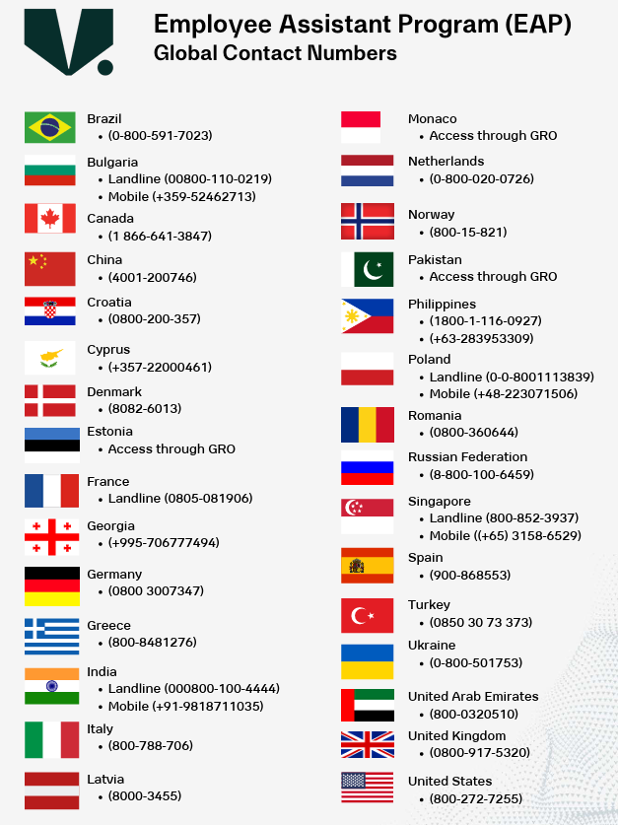
EAP Monthly Wellbeing Webinars
3 Steps:
1. Call your local number on the list.
2. Let them know you’re with V.Group (no need to provide any details of your name/position).
3. Someone will arrange a call back in your preferred language.
EAP Contact Numbers

Slide 7
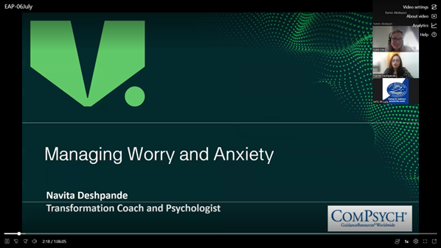
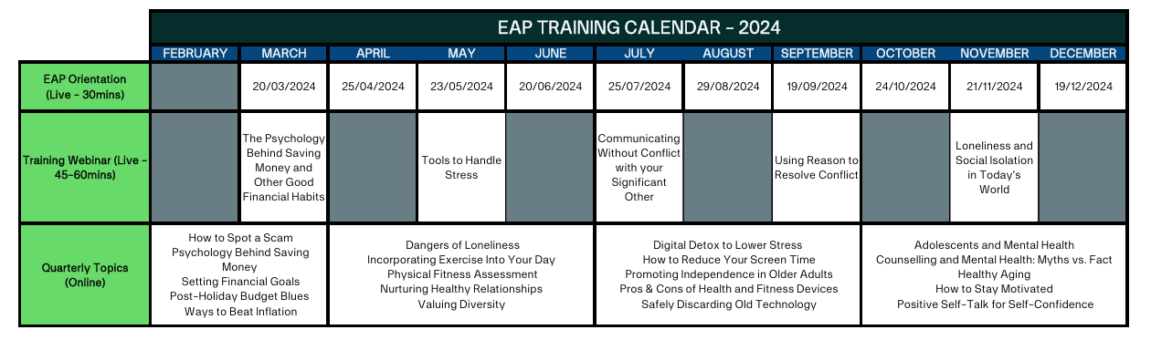
Monthly Wellness Training Sessions
EAP Orientation
Hosted by qualified psychologists
Topics covering mental wellness, work/life balance
Guest speakers from seafarer charities

